Slide 1
Games We Play
DevOps Games

Slide 2
DevOps Principles Exercise

Slide 3
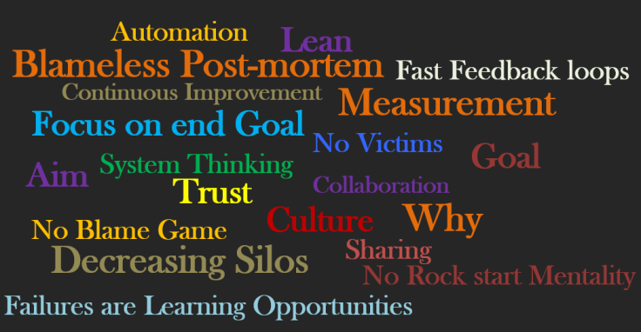
Apply These Principles

Slide 4
Exercise – Tie threads to a pen, all members together draw a triangle on paper
Tie the thread to pen
Every member will have thread which is tied to the same pen
Without touching the pen and paper. draw triangle on the paper
Stop at 5 min, analyze current condition, ask below questions
What did you plan as your Last Step?
What did you Expect?
What Actually Happened?
What did you Learn?
REPEAT 3 times

Slide 5
Lean Exercise

Slide 6
Exercise - Lean
Team exercise: we have ten brochures to send and mailing each brochure requires four steps:
Write a symbol on each paper. Each symbol is unique
Fold the paper such that the symbol is visible
Insert the paper into the envelope such that the symbol is on the same side as the flap of the envelope
Seal the envelope
Write the symbol on the envelope

Slide 7
Group A – Small Batch Release
Small Batch release team
What will you do?

Slide 8
Big-bang Release
Everything goes out all at once
Same stage for all the work for all the envelopes at a given time

Slide 9
Learning
Time-to-market – Small batch releases deliver products faster.
MTTR – If any bugs found this can be addressed immediately without much of rework as feedback is received early in development.
Quality – Small batch releases product with high quality.
Waste – Small batch release eliminates waste.
WIP – work in progress items will be reduced as team concentrates on single-piece-flow.
continuous deployment – where each change committed to version control is integrated, tested and deployed into production
Notes:
https://devopsgames.com/2017/08/23/lean-simulation-small-batch-release/#more-119

